Slide 1
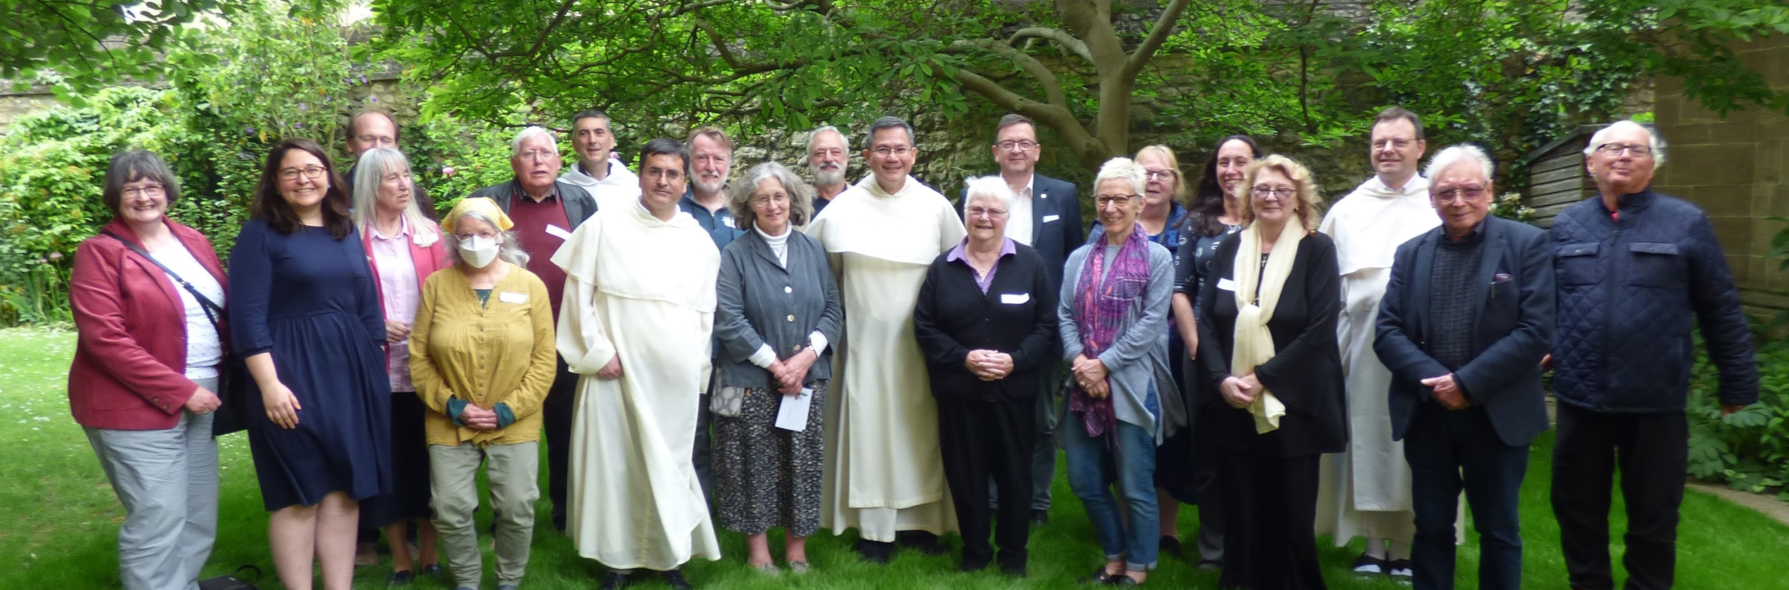
Lay Dominicans English Province
Annual General Meeting 2023
Notes:
I’m going to give a very brief overview of the past year.
Then we will hear from a few members of the Council on the issues they are leading on, and then there will be time for questions.
I frequently use this photo – it’s on our website and Facebook page.
It was taken just over a year ago, when the Master of the Order was visiting. The reason we use it so often is that, not only does it have the Master and our Provincial, fr. Martin, it also includes Lay Dominicans from a really wide range of our Fraternities.

Slide 2
The Provincial Council
Margaret Doyle: President
Fernando Cervantes: Vice-President
Andy Doyle: Directory Review
Gigi Horsfield: Secretary
Teresa Jankowska: Communications
Philip Owens: Treasurer
Sara Parvis: Formation
Catherine Wallis-Hughes: Events
Fr. John Farrell OP: Provincial Promoter
Sr. Rose Rolling OP: representing the sisters
Notes:
The Provincial Council was elected at a chapter meeting in October 2022.
So this is the first AGM for this Council, and I’d like to put on record our thanks to Alison, my predecessor as President, and to the previous council for all their work, which has given us such a strong starting point.
There are 8 elected council members, and of course, fr. John, who is the Provincial Promoter of the Laity: I hope you’ve had a chance to meet them during the day.
The photo was taken at the chapter meeting where we were elected. Since then, we’ve been joined by Sr. Rose, who attends our meetings to represent the sisters, and ensure that we continue to work together as the Dominican family.
As you can see, each elected member of the Council has a particular role.

Slide 3
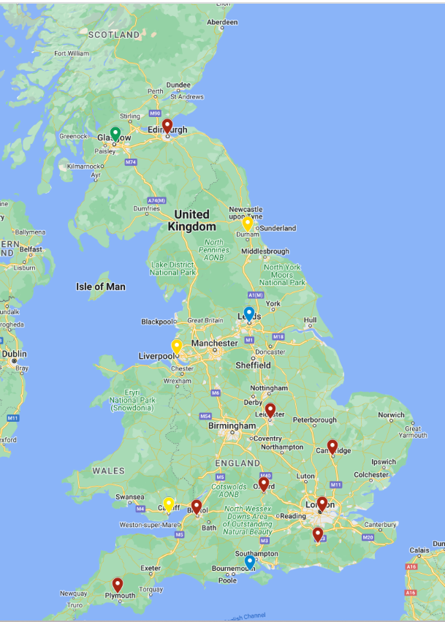
The Province
Fraternities: 8
Fraternal Groups: 3
New groups: 2
Notes:
First of all, some basic information about the Province.
We have 8 full fraternities, and 3 Fraternal Groups, not at the moment with enough members to elect a full fraternity council, and therefore relying on the Provincial Council for support.
Highlight: 29th April: Crawley celebration Mass, as the Fraternal Group became a Fraternity.
New groups:
Lymington and Yorkshire.
Please keep them in your prayers.

Slide 4
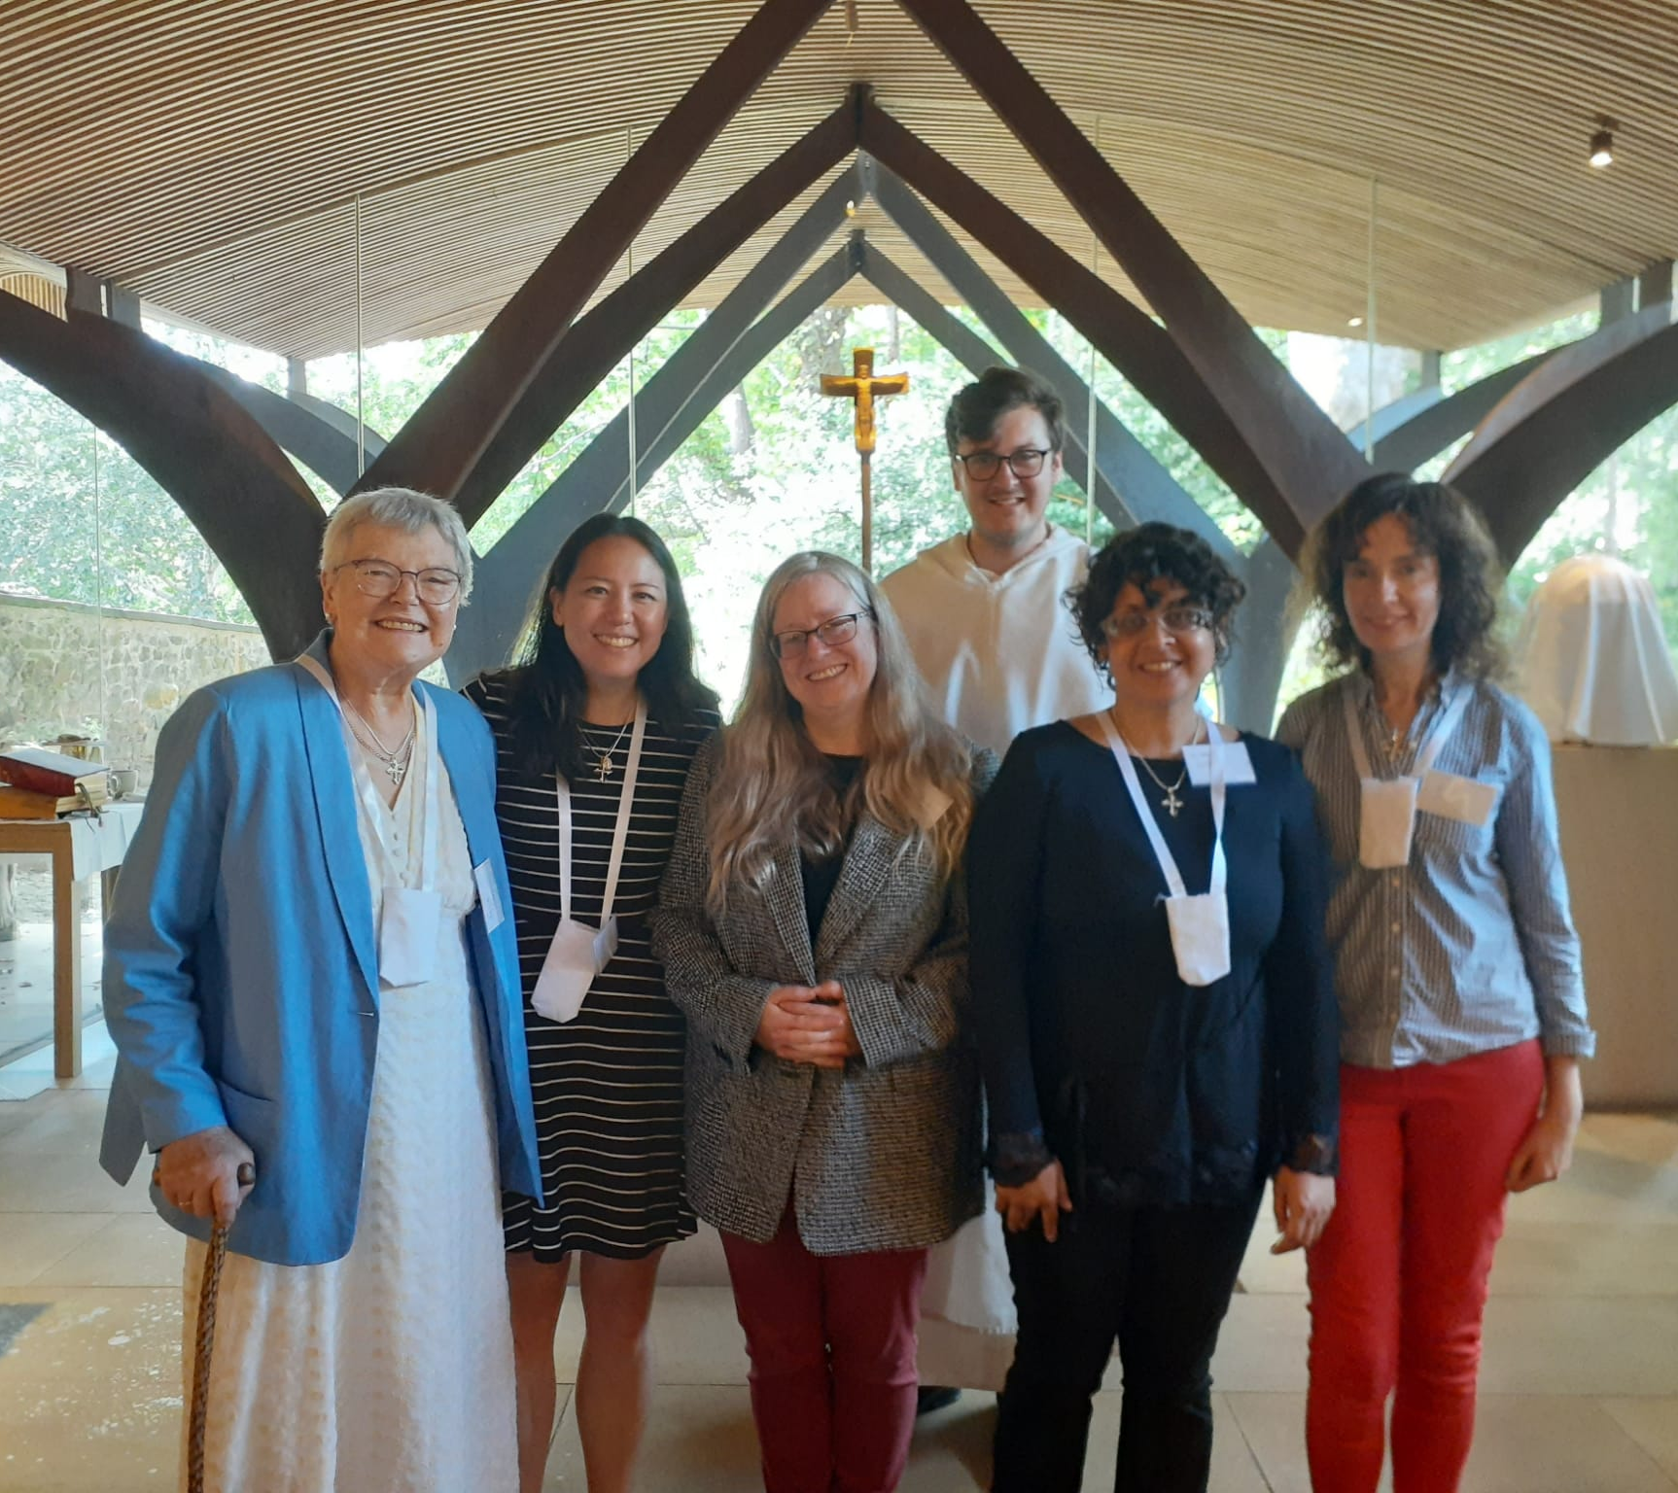
Lay Dominicans in our Province
Fully professed: 117
Simply professed: 22
Admitted: 23
Total: 163
Notes:
There’s a health warning on the figures – our record keeping isn’t as good as it could be (but we’re working on it!).
We have 163 Lay Dominicans, 13 admitted since the figures were put together for the Master’s visit. The picture shows the 4 most recent admissions, in Edinburgh.
And this does not include enquirers who have not yet been admitted (I know of at least 20!).
The most notable thing from these figures is that (even without the 20 enquirers) 27% of Lay Dominicans are admitted or simply professed.
This means that 27% are at an early stage of their lives as Lay Dominicans.
This ties in with one of the themes that really stands out from my first (not quite a year) as president. We have so many enquirers – so many people coming to find out more about the Dominican way of life and exploring if they are called to be Lay Dominicans.
And of course, we have also lost some Lay Dominicans in the last year.

Slide 5
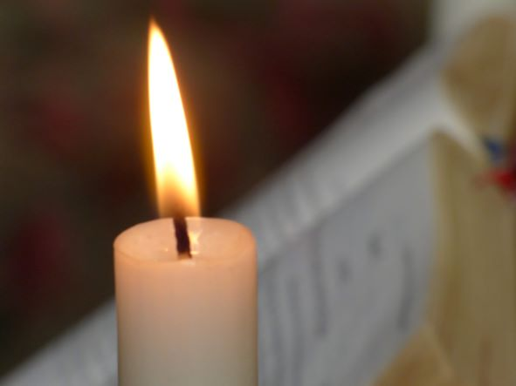
Rest in Peace
Pamela McNeil (Cambridge)
Ted Bachell (London)
Rev. Nick Baggio (North-West)
Maureen Hawkes
Anna Baidoun (Oxford)

Slide 6
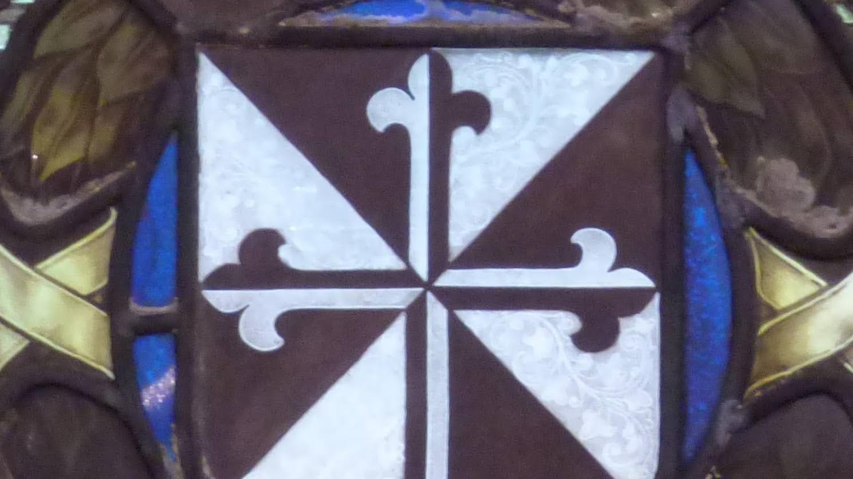
Highlights: Working with the Fraternities
Regular communications following Council meetings
Visits to Fraternities and group meetings
Occasional Zoom calls with Fraternity presidents
Sara’s calls with Formation Officers
Teresa’s network of communications contacts
Regional day in Edinburgh
Notes:
What we have been doing over the last year.
One of the highlights is the way we have been increasing communication between the Provincial Council and the fraternities, building on some of the things put in place by the previous council.
Information in emails, to pass on to everyone.
I have so far visited Lymington, Crawley, Yorkshire, Edinburgh and NW
Discussions when needed:
How we publicise our presence in our Dioceses
Communicating the decision about use of the post-nominal OP
Sara’s calls and Teresa’s network
Very successful day in Edinburgh, organised by Catherine
Of course, the aim of all this is to build real relationships between the fraternities and to build community across the province.

Slide 7
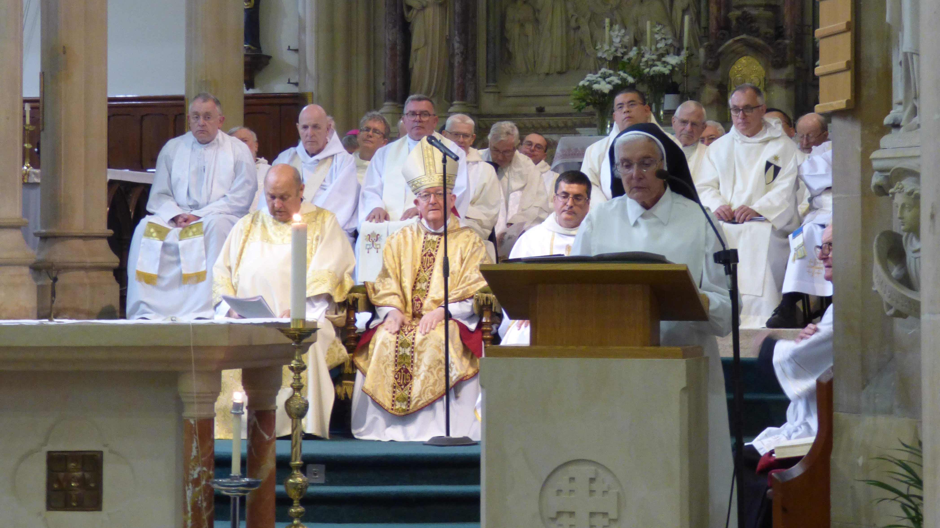
Highlights: The Dominican Family
Dominican Seminar: ‘Being Prophetic: Reading the Signs of the Times’
Mass of Thanksgiving at Stone
‘St. Dominic and His Preachers of Grace’ conference in Edinburgh
150th Anniversary of St. Dominic’s Church in Newcastle
Notes:
One of the other really positive themes is how we work together across the Dominican family: it’s always a joy when we all come together,
The seminar is always a good meeting place between the branches of the family. The next one, should already be in your diaries, but if it’s not: 1-3 March 2024, in Leeds.
A great conference in Edinburgh, organised by fr. Dermot, concentrating on the Dominican presence in Scotland, and with contributions from many Lay Dominicans.
Stone: the sisters at Stone were so grateful that many Lay Dominicans attended their thanksgiving Mass as they move out of the convent at Stone. Sr. Terry said to me that it really did feel like the family gathering around them to support them.
Just a week ago, it was the 150th anniversary of St. Dominic’s church in Newcastle. Although the friars are no longer based there it was good to have a Dominican presence at the Mass – 3 of the friars were able to attend, and 3 Lay Dominicans too. One of the parishioners at St. Dominic’s called the church itself, as well as the NE Fraternal Group, a Dominican presence in the NE.

Slide 8
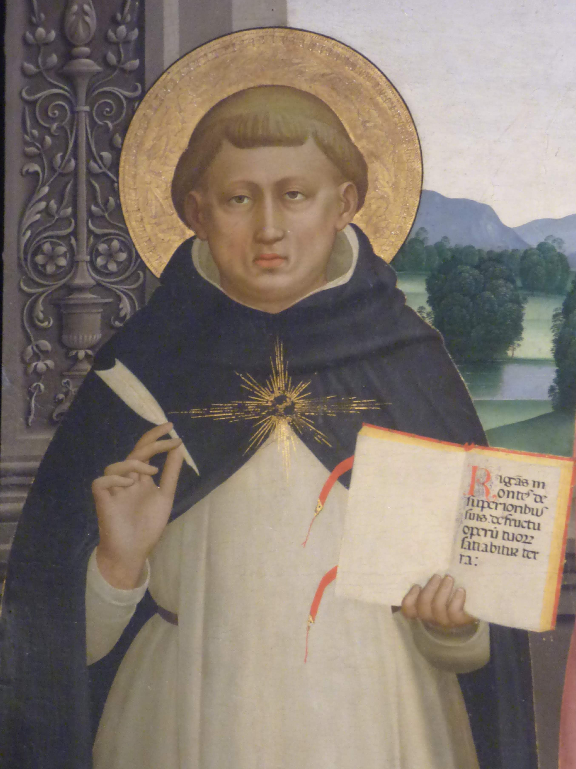
Current things we’re working on
‘Housekeeping’
Governance
Database
Main business
Supporting new and Fraternal Groups
Aquinas Jubilee
Community
Notes:
A couple of admin / housekeeping things.
We’ve started talking about governance. Anyone who has tried to set up a bank account for a fraternity will know that even the banks struggle to understand what sort of an organisation we are. We’re not a charity, or a business. We certainly don’t want to interfere with the way that fraternities run themselves, but we’re thinking about some brief good practice suggestions on the key governance issues (safeguarding, data protection & finance).
We need to get better at record keeping, so we’re planning a database of Lay Dominicans with the basic information we need.
We’ll be in touch with Fraternity presidents about this soon.
Main business for the Council to discuss
Support for new & Fraternal Groups
Should we be doing more for the Aquinas Jubilee? What would you like to see? Are you doing anything in your fraternities? Let us know.
Community: a few things recently have made me think that we need to discuss what community, one of the 4 pillars of Dominican life, means to Lay Dominicans. I won’t go into detail now, but perhaps a synodal-type discussion on this?

Slide 9
Financial Report: Philip
Directory Review: Andy
Communications: Teresa
Formation: Sara

Slide 10
Any Questions?

